Slide 1
Introduction to MADARA and GAMS
James Edmondson
Notes:
Title Slide
Title and Subtitle text blocks should not be moved from their position if at all possible.

Slide 2
Copyright 2016 Carnegie Mellon University This material is based upon work funded and supported by the Department of Defense under Contract No. FA8721-05-C-0003 with Carnegie Mellon University for the operation of the Software Engineering Institute, a federally funded research and development center. Any opinions, findings and conclusions or recommendations expressed in this material are those of the author(s) and do not necessarily reflect the views of the United States Department of Defense. NO WARRANTY. THIS CARNEGIE MELLON UNIVERSITY AND SOFTWARE ENGINEERING INSTITUTE MATERIAL IS FURNISHED ON AN “AS-IS” BASIS. CARNEGIE MELLON UNIVERSITY MAKES NO WARRANTIES OF ANY KIND, EITHER EXPRESSED OR IMPLIED, AS TO ANY MATTER INCLUDING, BUT NOT LIMITED TO, WARRANTY OF FITNESS FOR PURPOSE OR MERCHANTABILITY, EXCLUSIVITY, OR RESULTS OBTAINED FROM USE OF THE MATERIAL. CARNEGIE MELLON UNIVERSITY DOES NOT MAKE ANY WARRANTY OF ANY KIND WITH RESPECT TO FREEDOM FROM PATENT, TRADEMARK, OR COPYRIGHT INFRINGEMENT. [Distribution Statement A] This material has been approved for public release and unlimited distribution. Please see Copyright notice for non-US Government use and distribution. This material may be reproduced in its entirety, without modification, and freely distributed in written or electronic form without requesting formal permission. Permission is required for any other use. Requests for permission should be directed to the Software Engineering Institute at permission@sei.cmu.edu. DM-0003732

Slide 3

Introduction
History
MADARA
GAMS
Next Steps
In this talk, we will discuss the capabilities, history and focus of the SEI-developed, open-sourced Multi-Agent Distributed Adaptive Resource Allocation (MADARA) and Group Autonomy for Mobile Systems (GAMS) open source projects
MADARA and GAMS have been consistent technologies used by the CPS-ULS group to provide predictable execution and knowledge sharing between a group of distributed autonomous systems

Slide 4
Introduction
History
MADARA
GAMS
Next Steps
MADARA first started development in 2009
Initially developed to support portable knowledge and reasoning, boolean logic and reinforcement learning for a pub-sub-based (DDS) distributed artificial intelligence
Over the years, it has grown to include support for
Generic distributed systems
Threading
Advanced quality-of-service
UDP-based transports (unicast, broadcast, multicast)
Ports to Java, Android, basic python support, etc.
Focus of development since inception
Quality-of-service with especial focus on timing and control
Scalability, speed, and expressiveness
Documentation (Wikis and doxygen documentation for all library calls)
Open-source release (BSD-licensed, no cost, freely available)
Extensibility for threading, transports and programming models (e.g., iterative versus reactive)

Slide 5
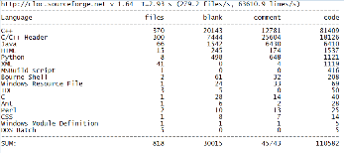
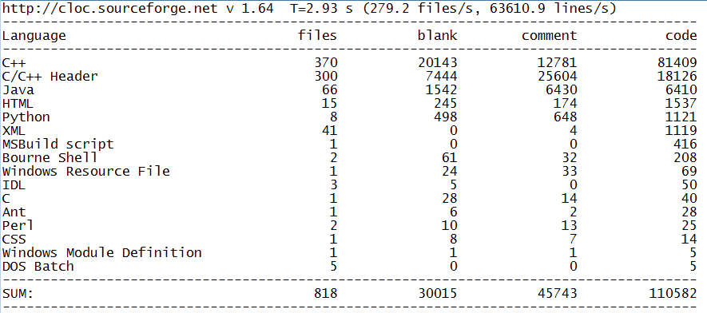
Introduction
History
MADARA
GAMS
Next Steps
MADARA is the larger of the two projects and has been developed for longer

Slide 6
Introduction
History
MADARA
GAMS
Next Steps
GAMS first started development in 2012 and built on top of MADARA
Initially started as SMASH, a project at SEI intended to support distributed algorithms for quadcopters in outdoor environments
Over the years, it has grown to include support for
Extensible algorithms
Extensible platforms
Advanced quality-of-service
Generic simulation environment support
Multi-step and dynamic algorithms (algorithms that execute other algorithms)
Ports to Java and Android
Focus of development since inception
Quality-of-service with especial focus on timing and control
Scalability, speed, and expressiveness
Open-source release (BSD-licensed, no cost, freely available)
Documentation (Wikis and doxygen documentation for all library calls)
Extensibility for new platforms and algorithms

Slide 7
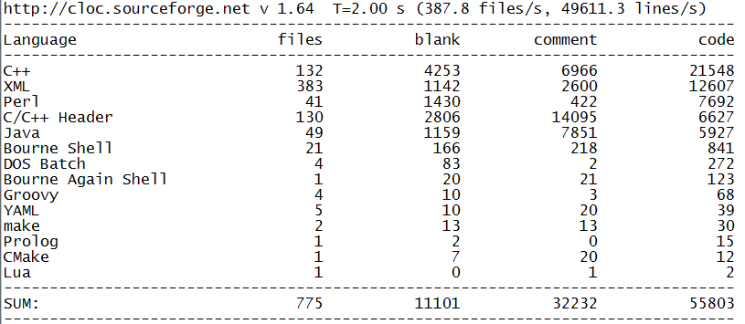
Introduction
History
MADARA
GAMS
Next Steps
GAMS is the smaller of the two projects and has been developed for a few years

Slide 8
Introduction
History
MADARA
GAMS
Next Steps
MADARA Overview
User applications interact with a Knowledge Base
The Transport layer transfers knowledge across a network
The Threader controls portable, knowledge-enabled threads
Knowledge Base
Application
Legend
Threader
Transport
Events
MADARA
Thread
Network
User
OS
OS

Slide 9
Introduction
History
MADARA
GAMS
Next Steps
GAMS Overview
GAMS is built on top of MADARA, so it inherits all of its features
User application features an autonomous system controller
Controller executes a distributed algorithm in a MAPE Loop
Algorithm interacts with a hardware or simulation platform
Controller
Application
Legend
Knowledge Base
GAMS
Events
Algorithm
MADARA
Threader
Transport
User
Network
Platform
Thread
OS
OS

Slide 10
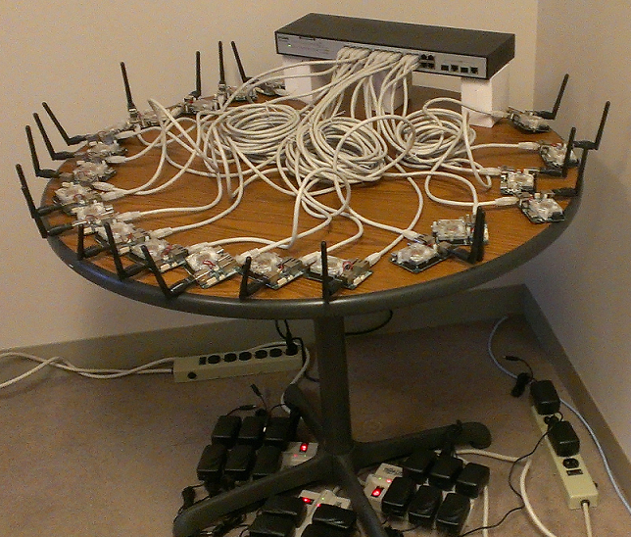
Introduction
History
MADARA
GAMS
Next Steps
Platforms and uses we have been targeting for GAMS
Distributed algorithms and platforms for quadcopters in outdoor environments (SMASH 2013, GAMS 2014)
Scalable and adaptive algorithms and platforms for Platypus Lutra boats in outdoor environments (ELASTIC 2015)
 | Min Hz | Max Hz | Avg Hz
Per Node Publish | 500.00 | 517.30 | 507.46
Per Node Receive | 432.00 | 490.00 | 468.12
Per Node Total Receive | 8,820.00 | 9,082.00 | 8,921.38
Total Throughput |  |  | 133,868.00
Platypus Node Publish | 5.00 | 35.00 | 31.00
Platypus Node Receive | 5.00 | 35.00 | 31.00
Platypus Per Node Total Receive | 100.00 | 700.00 | 620.00
Platypus Total Throughput |  |  | 12,400.00
Estimated boat scaling | 1764 | 240 | 280

Slide 11
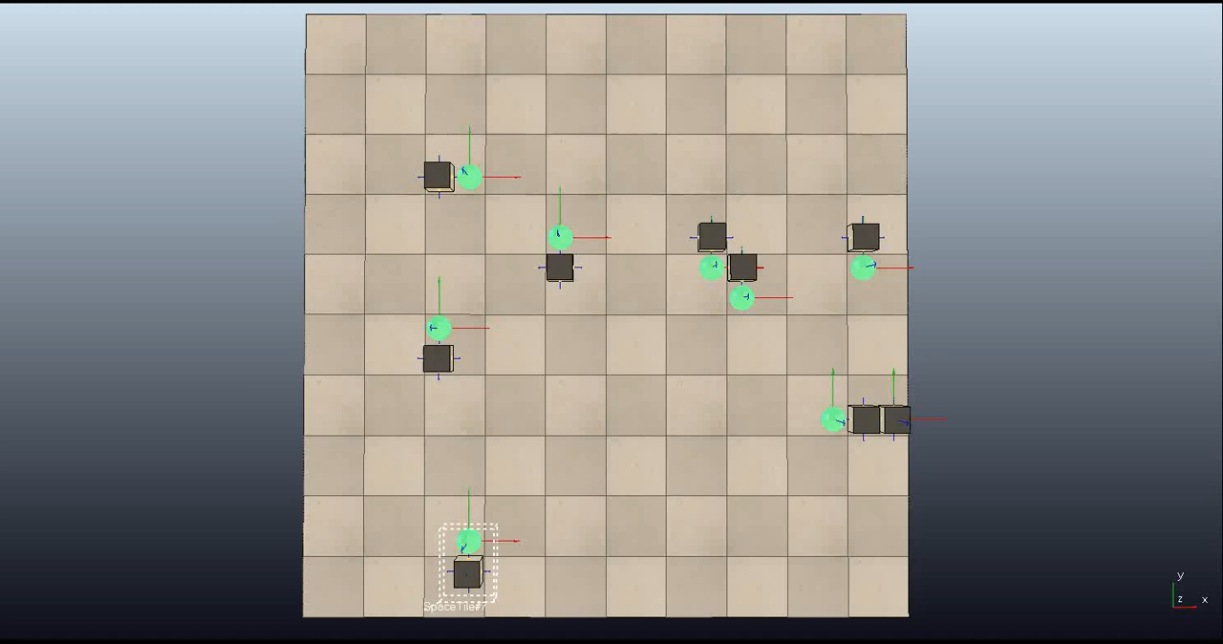
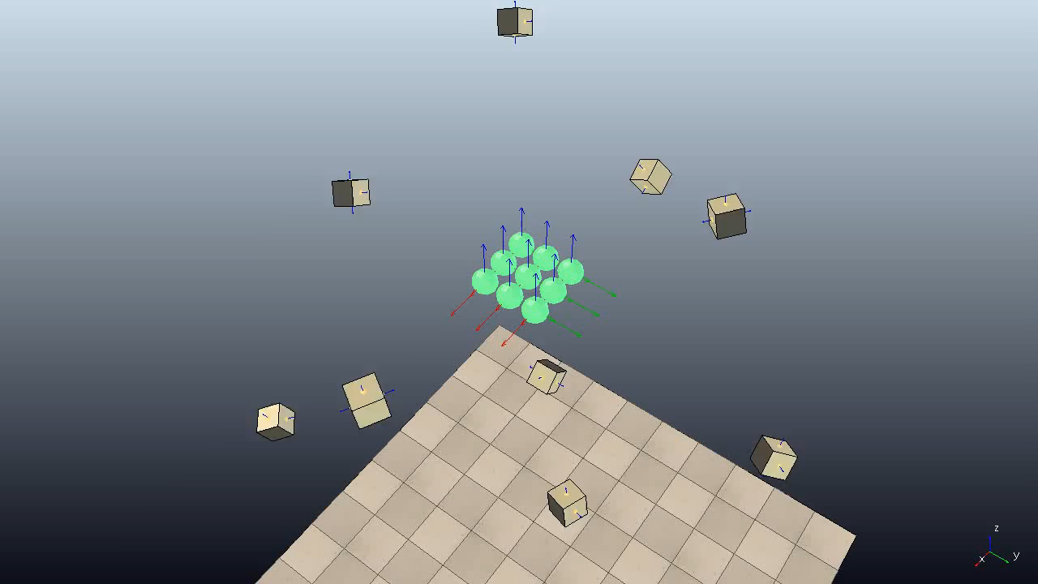
Introduction
History
MADARA
GAMS
Next Steps
Platforms and uses we have been targeting for GAMS
Adversarial algorithms for Platypus Lutra boats in outdoor environments (MADPARTS 2016)
Zone Defense
Onion Defense
enemy
protector
asset
zone
Simulation infrastructure for verification techniques like DART and DEMETER (Day 2 topics, 2015-16)

Slide 12
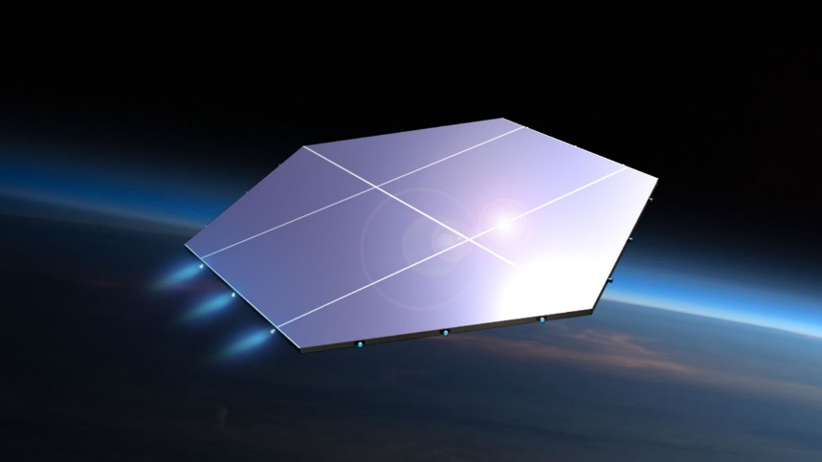
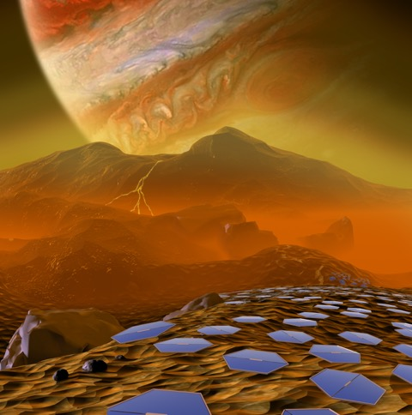
Introduction
History
MADARA
GAMS
Next Steps
Platforms and uses we have been targeting for GAMS
Simulation and real-world infrastructure for platforms and algorithms for Multi-Planetary Smart Tile (2016-future), currently in development at GE GRC

Slide 13
Introduction
History
MADARA
GAMS
Next Steps
Next steps in this tutorial series
[10:00] Installing MADARA and GAMS
[10:45] Using the GAMS project configuration tool
[12:45] Creating multi-threaded applications and controllers
[13:30] Creating distributed algorithms
[14:45] Creating hardware and simulation platforms

Slide 14
James Edmondson
Email: jredmondson@sei.cmu.edu
U.S. Mail
Software Engineering Institute
4500 Fifth Avenue
Pittsburgh, PA 15213-2612 USA
Website
www.sei.cmu.edu/contact.cfm

